Slide 1

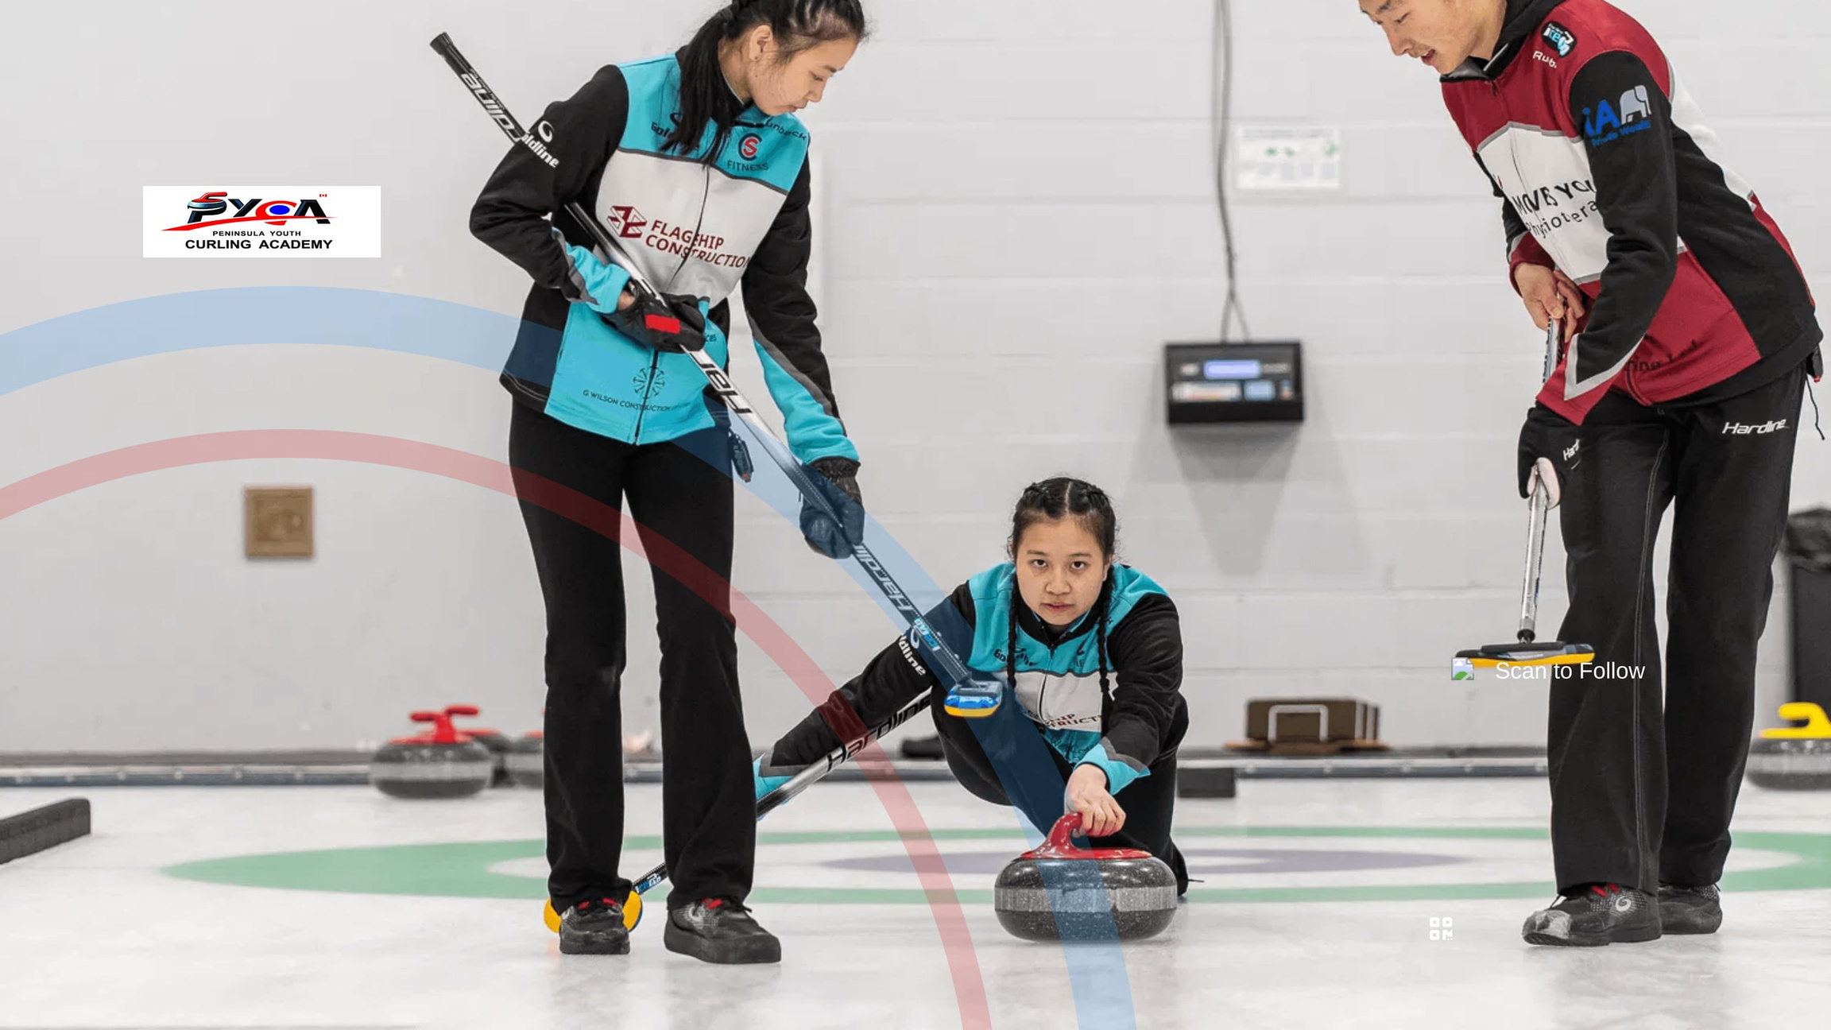


INSPIRING THE NEXT GENERATION
Peninsula Youth
Curling Academy
SCAN TO FOLLOW
Strategy. Skill. Teamwork. Fun.
Home for Curling.
Copyright © PYCA. All rights reserved.

Slide 2

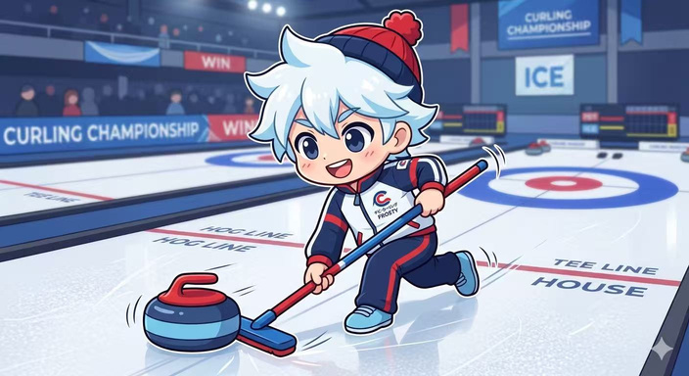

THE BIG QUESTION
Why is CURLING the perfect sport for your child?
Copyright © PYCA. All rights reserved.

Slide 3





Build Champions On and Off the Ice
SHINE IN CANADA’S NATIONAL WINTER SPORT
Strategic thinking
True team sport
Curling is Chess on ice
Communication and teamwork on every stone
Focus and composure
Chance to be a champion
Practice patience and emotional control under pressure
in Canada’s national winter sport
Copyright © PYCA. All rights reserved.

Slide 4
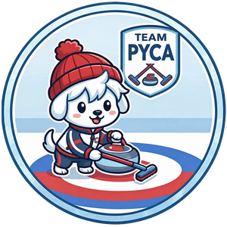
Fun Fact 1
Do you know curling is known as
the world's most strategic sport?
“Chess on Ice”
FAST. SLIDE SMOOTH. WIN TOGETHER.
Every shot is a smart decision. A high-stakes game of strategy and physics.
Copyright © PYCA. All rights reserved.
Notes:
4

Slide 5


THE PERFECT SPORT
WHY CURLING?
STRATEGIC MINDSET
ELITE TEAMWORK
LIFELONG COMMUNITY
Often called "Chess on Ice," curling develops critical thinking and long-term planning.
Success depends on synchronized communication and absolute trust in your teammates.
A sport of deep tradition where friendships formed on the ice last a lifetime.
Copyright © PYCA. All rights reserved.
Notes:
5

Slide 6
A JOURNEY THROUGH TIME
How did a 500-year-old game become a Canadian classic?
Copyright © PYCA. All rights reserved.

Slide 7



500 YEARS OF HERITAGE
A JOURNEY THROUGH TIME
1541
1807
1927
SCOTLAND
CANADA
FIRST BRIER
The first recorded game on frozen ponds in Paisley, Scotland.
The Montreal Curling Club was founded, starting a national tradition.
The first Brier was held in Toronto. Curling became a true Canadian national sport.
Copyright © PYCA. All rights reserved.
Notes:
7

Slide 8
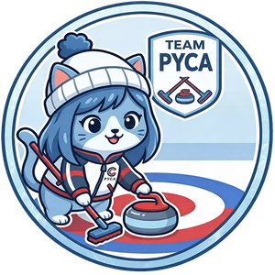
Fun Fact 2
How many curling rinks in Canada?
“Nearly 1000”
Curling rinks spread across the country!
Copyright © PYCA. All rights reserved.

Slide 9
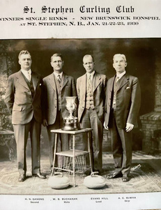

A CANADIAN TRADITION
NATIONAL PASSION
SPORTSMANSHIP
COMMUNITY
TRADITION
The born of Brier became the centerpeiece of Canadian curling culture. It grew into the most watched and attended curling event in the country.
It turned curling from local games into a true national sport.
Copyright © PYCA. All rights reserved.

Slide 10
Fun Fact 3
When did curling first become an official medal sport at the Winter Olympics?
“1998 in Nagano Japan”
The oldest sport in the winter Olympics.
Copyright © PYCA. All rights reserved.

Slide 11

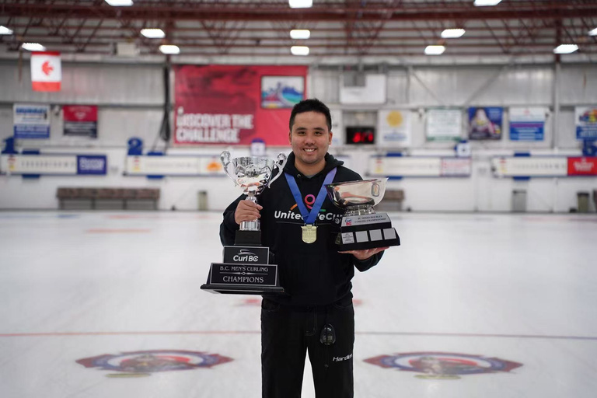


A LEGACY OF EXCELLENCE
THE HEART OF THE SPORT BEATS IN CANADA
OLYMPIC GLORY
Canada leads the world in Olympic medals and international titles since 1998.
TEAM BC
GLOBAL LEADERS
From local club fun to Provincial and National Champions.
Setting the standard for excellence, strategy, and sportsmanship.
Copyright © PYCA. All rights reserved.
Notes:
11

Slide 12
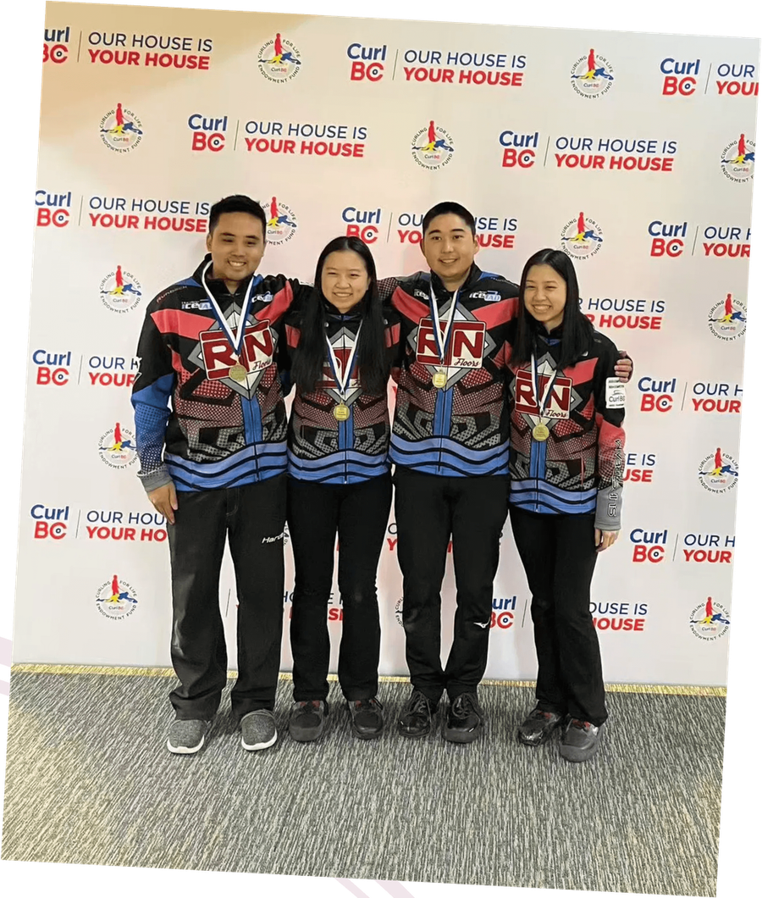
THE PATHWAY TO EXCELLENCE
FROM CLUB TO TEAM BC
Local Club Play
Where the passion begins in White Rock.
Provincial Stage
Competing against the best in BC.
National Champions
Representing BC on the global stage.
Copyright © PYCA. All rights reserved.

Slide 13
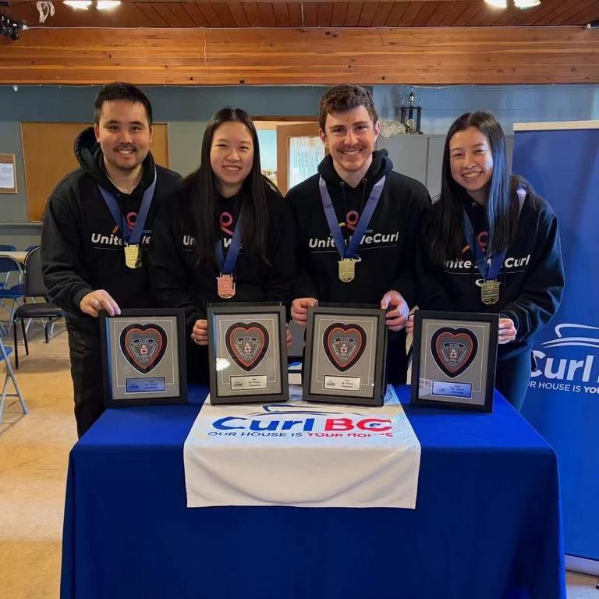
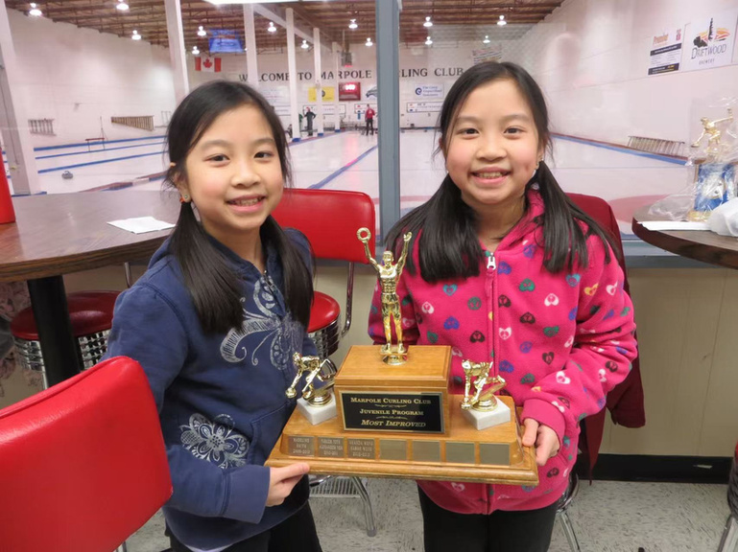
SKILLS FOR LIFE
How does Curling Build Future Leaders?
Copyright © PYCA. All rights reserved.

Slide 14


THE JOURNEY CONTINUES
From the Podium
to the Classroom
How Olympic values of excellence and respect build
the leaders of tomorrow.
Copyright © PYCA. All rights reserved.

Slide 15
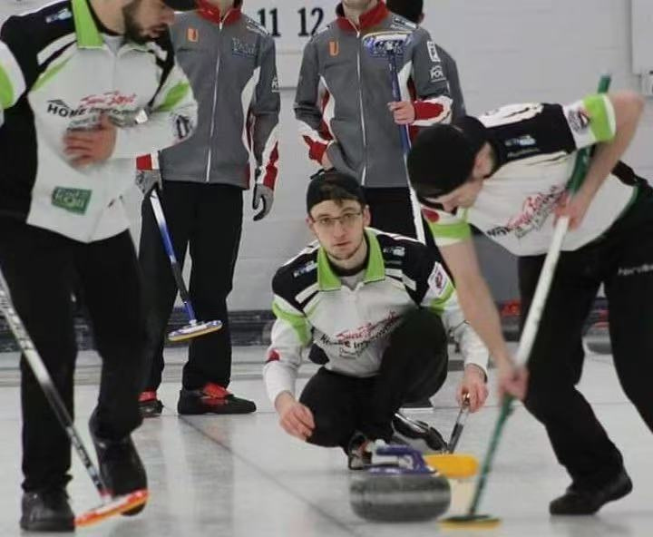
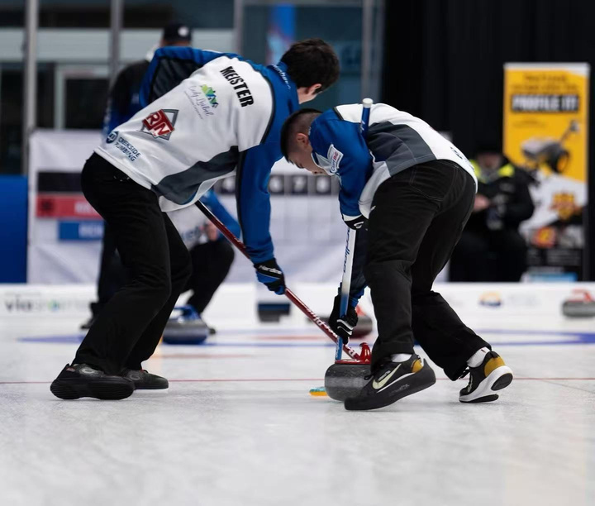
WHICH ROLE FITS YOU ?
THE SKIP
THE SWEEPERS
LEADERSHIP
TEAMWORK
Calling the Shots
Sweeping in Sync
Learn to strategize, communicate clearly, and lead your team to victory.
Success depends on every player working together in perfect harmony.
WHICH ROLE FITS YOU?
Copyright © PYCA. All rights reserved.

Slide 16
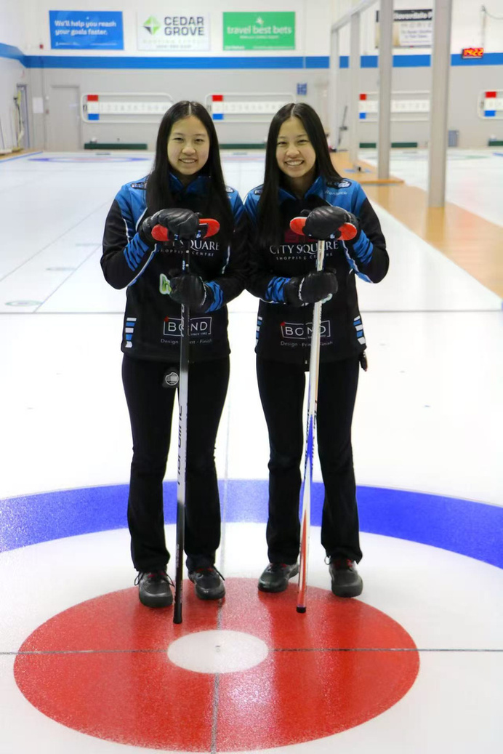



MENTAL DEVELOPMENT
CALM MINDS,
COLD ICE
Unwavering Focus
Every stone requires total concentration and strategic foresight.
Patience & Control
Learning to stay calm under pressure and wait for the perfect shot.
Lasting Confidence
Success on the ice builds self-belief that carries into school and life.
Copyright © PYCA. All rights reserved.

Slide 17
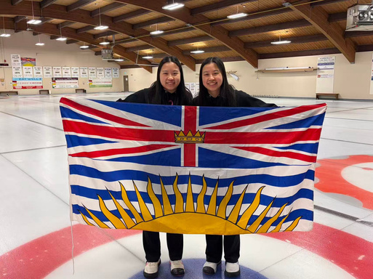
THE NEXT CHAPTER
Could your Child be Our Next Champion?
Copyright © PYCA. All rights reserved.

Slide 18
Fun Fact 4
Which country creates the most curlers in the world?
“Canada”
nurtures 90% of the world's ice curlers
Copyright © PYCA. All rights reserved.

Slide 19
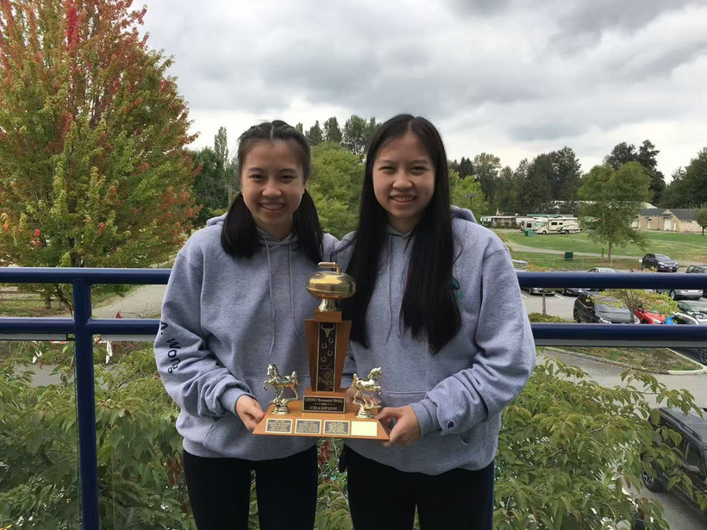
LOCAL SUCCESS
FROM KIDS TO CHAMPIONS
JOIN US TO START YOUR JOURNEY
Copyright © PYCA. All rights reserved.

Slide 20
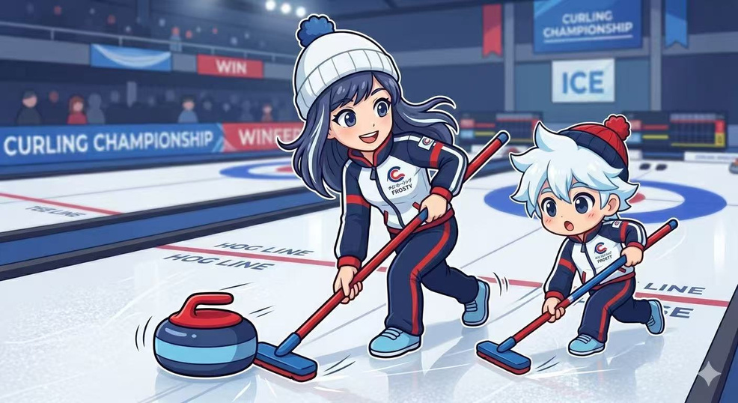
YOUTH PROGRAMS
Join the Fun
Beginners Welcome!
No experience needed.
Open to all kids, cultures, and abilities.
We provide the equipment — you bring the energy!
GRADE 5 – 12,
REGISTER DETAIL
Copyright © PYCA. All rights reserved.
Notes:
20

Slide 21



YOUTH OPPORTUNITY
BUCHANAN SCHOLARSHIP
2ND PLACE
1ST PLACE
3RD PLACE
$2,000
$3,000
$1,000
AWARD
AWARD
AWARD
Visit pyca.ca for details
Copyright © PYCA. All rights reserved.
Notes:
21

Slide 22
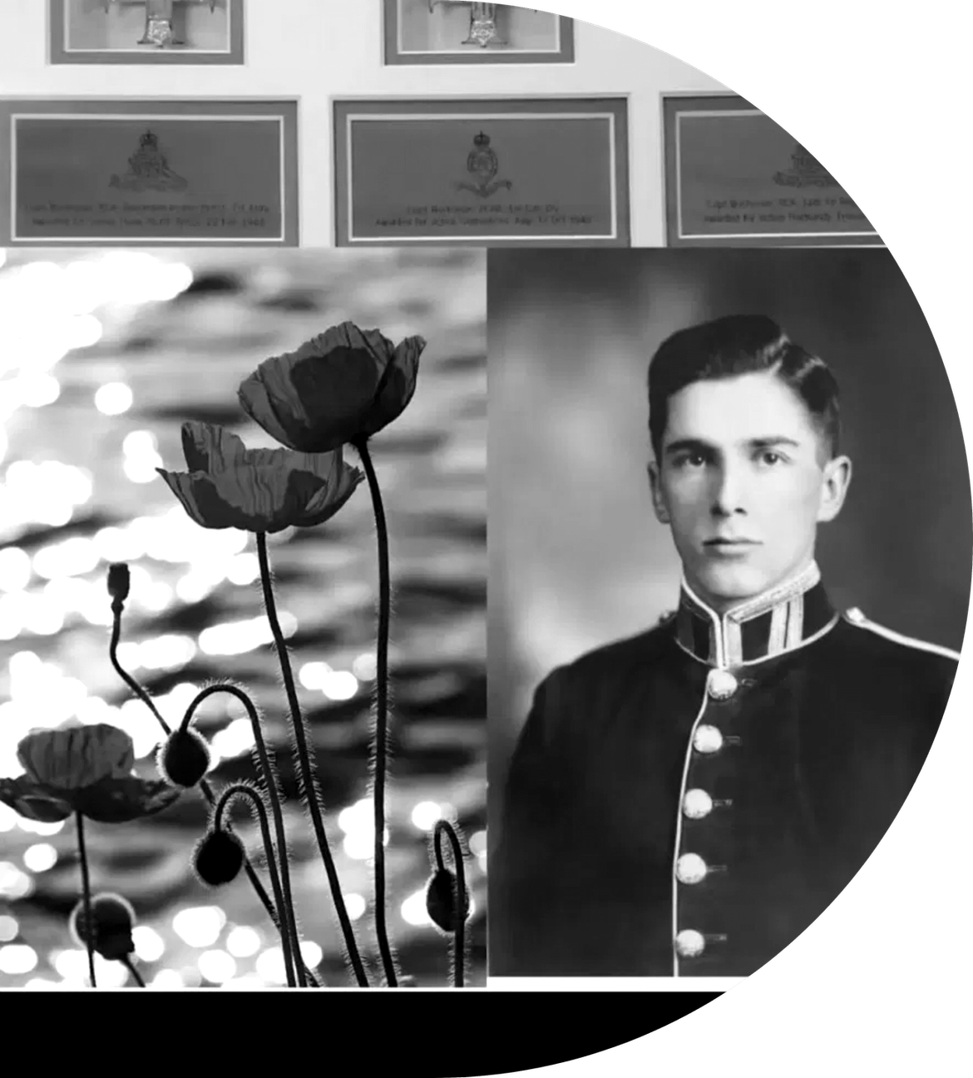


THE HERO BEHIND THE NAME
NORMAN BRUCE
BUCHANAN
One of only 15 soldiers in the entire history of the British Empire to earn the honor of 3 Military Crosses for Bravery.
Decorated by King George VI
Notes:
22

Slide 23



LOCAL HERITAGE
The Buchanan Family
made the new PACC possible with the mission of building a community that lasts for generations.
A CENTURY OF CURLING
100-Year Family Tradition
Grandfather founded our first club in 1925.
60+
YEARS OF
PRIDE
Friendships for Life
"Building bonds that last until the very end."
Honor & Privilege
PEACE ARCH
Curling Club
"It's a privilege to give back to the community."
Copyright © PYCA. All rights reserved.

Slide 24
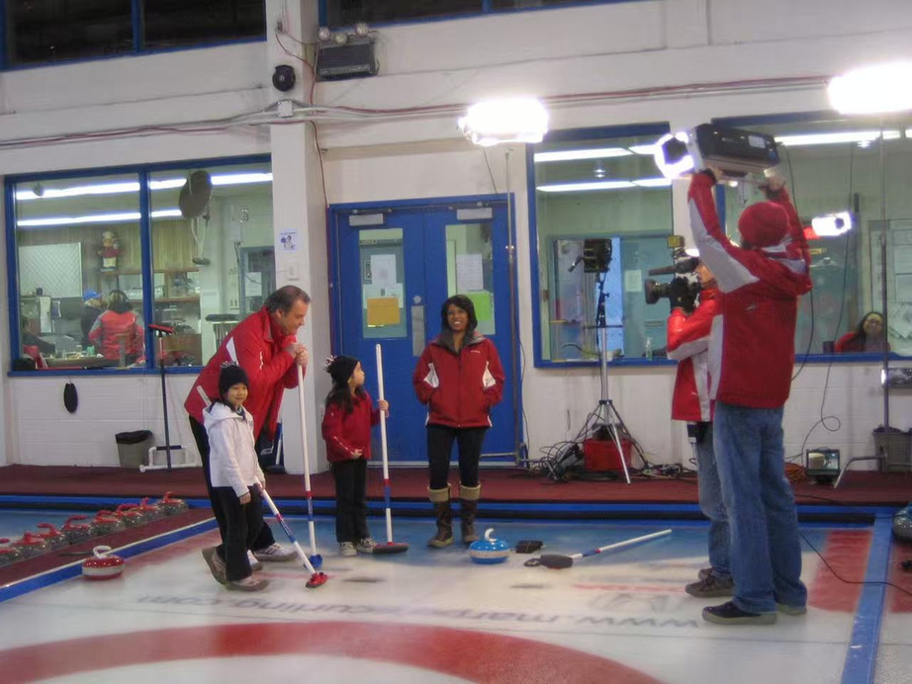
GROWING FOR THE FUTURE
New Ice,
Rapid Growth
Nearly 600
Active members in our community
"If all municipalities can do it — why not White Rock? We are revitalizing to ensure a world-class home for our youth."
Revitalizing for 2026
Copyright © PYCA. All rights reserved.

Slide 25
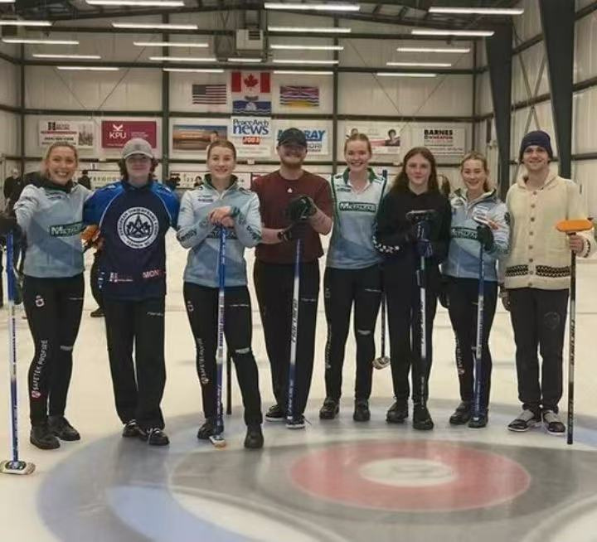
OUR HOME, OUR MISSION
The Peace Arch Story
The Peach Arch Curling Club (PACC) is the heart of our community. Together with the Buchanan Legacy, we are building a world-class environment where youth can thrive, compete, and lead.
Copyright © PYCA. All rights reserved.

Slide 26
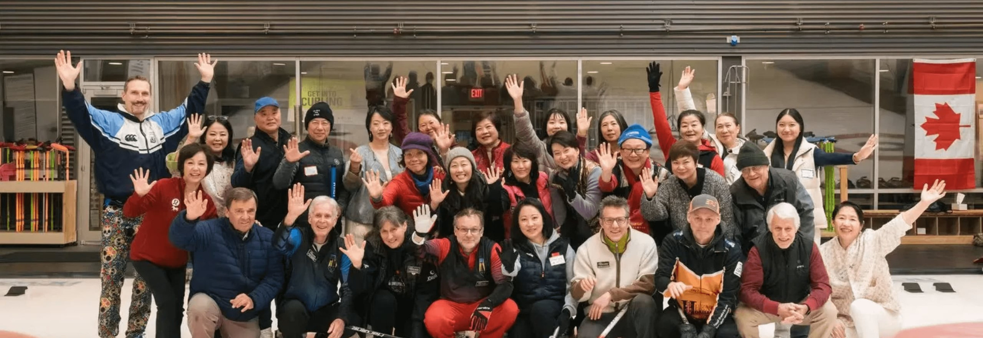
JOIN THE FUN
Our A VIBRANT &
INCLUSIVE COMMUNITY
Building the future of curling together,
one stone at a time.
Copyright © PYCA. All rights reserved.

Slide 27
REGISTRATION NOW OPEN
YOUR STORY
COULD BE NEXT
September Intake Ongoing
SCAN TO JOIN
Visit pyca.ca for details
Copyright © PYCA. All rights reserved.
Notes:
27

